Slide 1
Time Series Analysis Of COVID-19 In India
VENKATAKRISHNAN.R (venkatkrishnan2003@gmail.com)
B SIVA JYOTHI NATHA REDDY (ss2619338@gmail.com)
SARTHAK YADAV (sarthaknyadav@gmail.com)

Slide 2
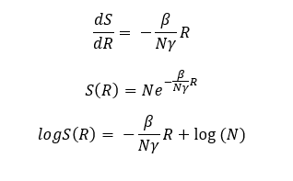
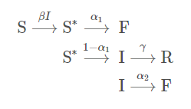
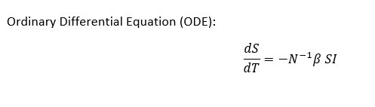
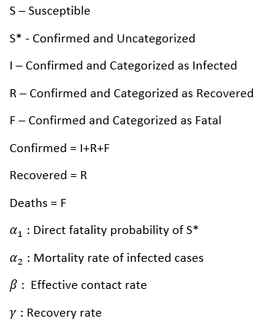
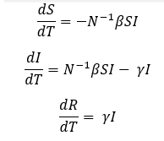
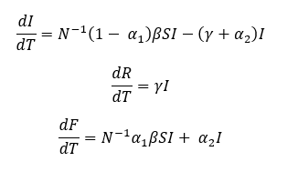
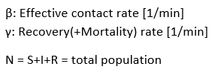
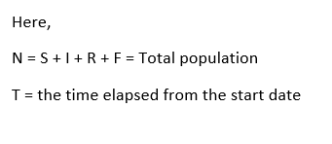
S-R trend analysis
SIR-F Model
SIR Model

Slide 3
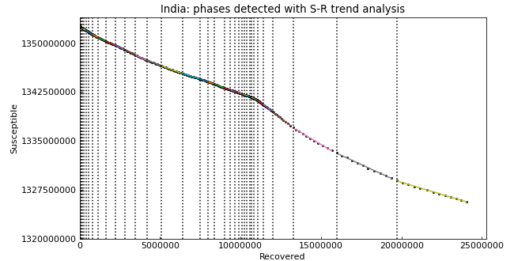
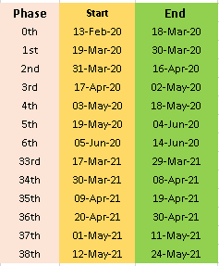
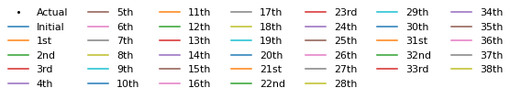
S-R Trend Analysis

Slide 4
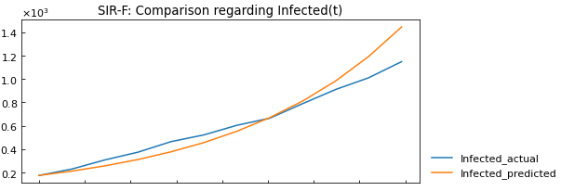
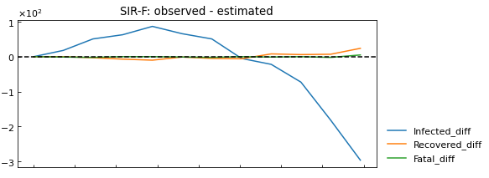
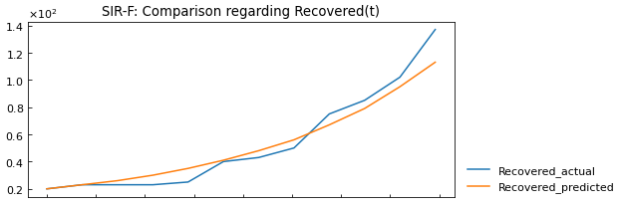
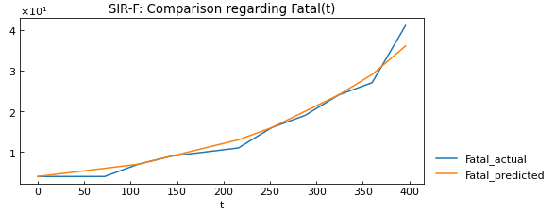

SIR-F Model Analysis

Slide 5
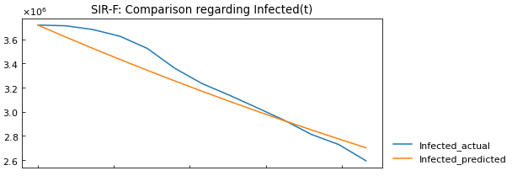
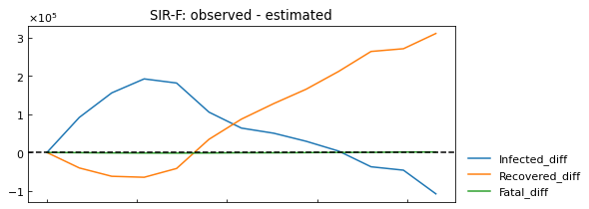
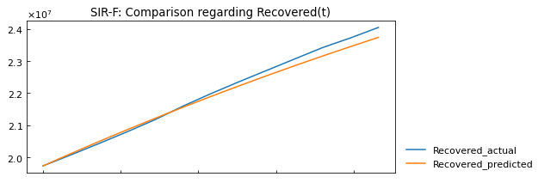
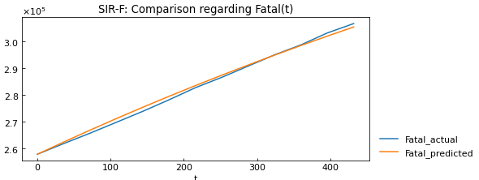

SIR-F Model Analysis

Slide 6
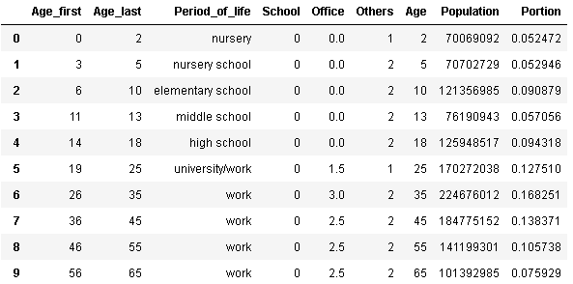
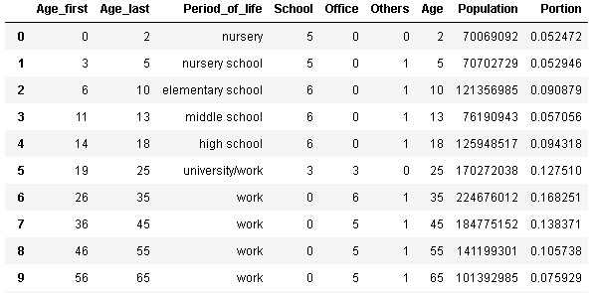

Lockdown Scenario Analysis
50 % Restriction
No Lockdown
3.4 days in a week susceptible people go out
6.2 days in a week susceptible people
meet each other
70 % Restriction
2.7 days in a week susceptible people go out

Slide 7
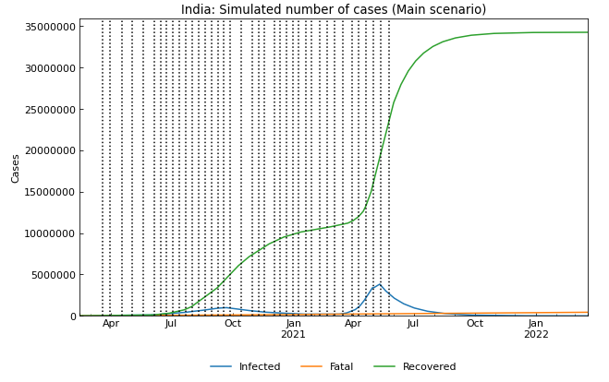
Predicting the Future
Date | Confirmed | Fatal | Infected | Recovered
30/06/2021 0:00 | 30421124 | 402026 | 481379 | 29537719
01/07/2021 0:00 | 30456522 | 403209 | 461127 | 29592186
02/07/2021 0:00 | 30490429 | 404343 | 441725 | 29644361
03/07/2021 0:00 | 30522910 | 405429 | 423140 | 29694341
26/07/2021 0:00 | 30987198 | 420952 | 157330 | 30408916
27/07/2021 0:00 | 30998655 | 421335 | 150766 | 30426554
28/07/2021 0:00 | 31009630 | 421702 | 144478 | 30443450
29/07/2021 0:00 | 31020150 | 422054 | 138452 | 30459644
30/07/2021 0:00 | 31030239 | 422391 | 132672 | 30475176
31/07/2021 0:00 | 31039925 | 422715 | 127123 | 30490087
04/08/2021 0:00 | 31074999 | 423888 | 107031 | 30544080
05/08/2021 0:00 | 31082889 | 424152 | 102511 | 30556226

